Slide 1
Plan of action: twitter topic modeling
Bálint Hantos
Supervisor: István Márkusz
DSLab – 23/9/2021

Slide 2

„You can neither remember nor forget what you do not understand”
Memory is vulnurable
Comfort vs. Accuracy of past events
Social media
Self-deception through false information
Preserved narrative structure
Img source: https://theconversation.com/people-with-depression-can-sometimes-experience-memory-problems-heres-why-153392

Slide 3
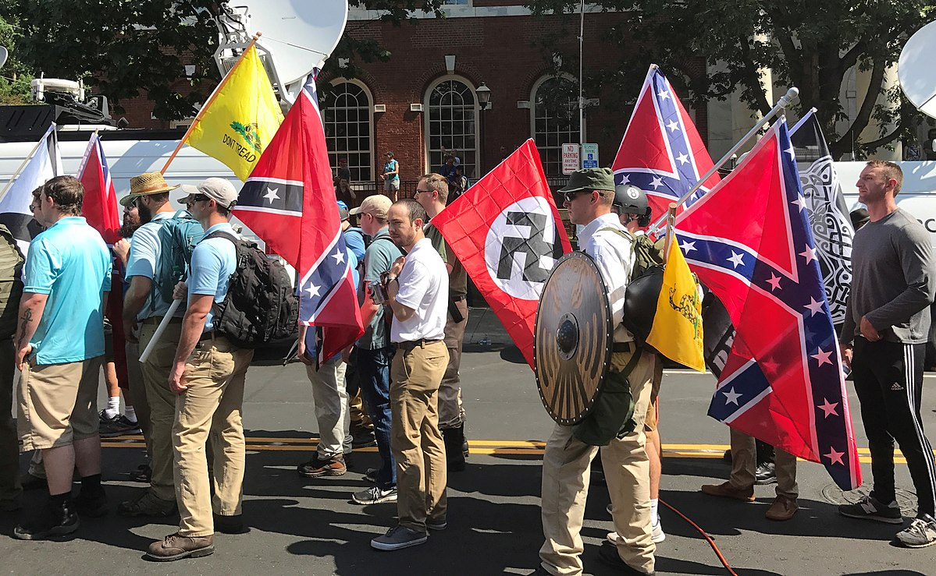
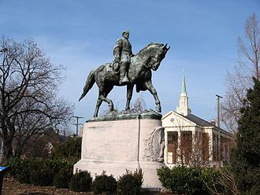
Charlottesville rally (2017)
Controversy: removal of confederate statue
Clashes between protestorts and anti-protesters
1 person killed,°~ 50 non-fatal injuries
Confederate statue - General Lee
Img source: Wikipedia – Unite the Right rally

Slide 4
Twitter - Charlottesville rally (2017)
Tweets: short text – dense in information

Slide 5
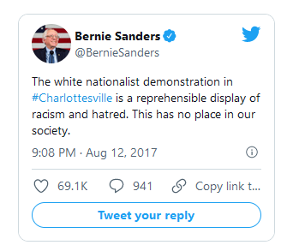
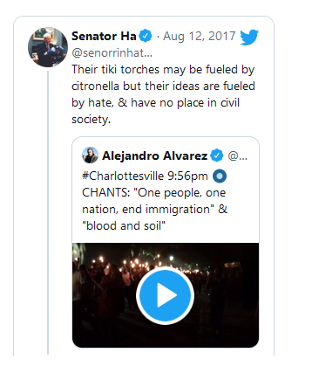
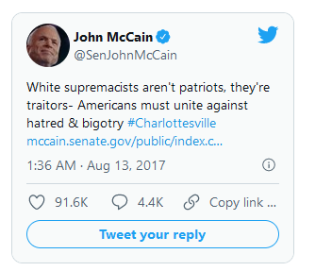
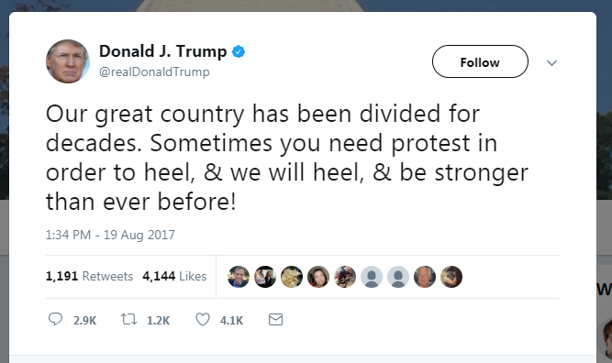
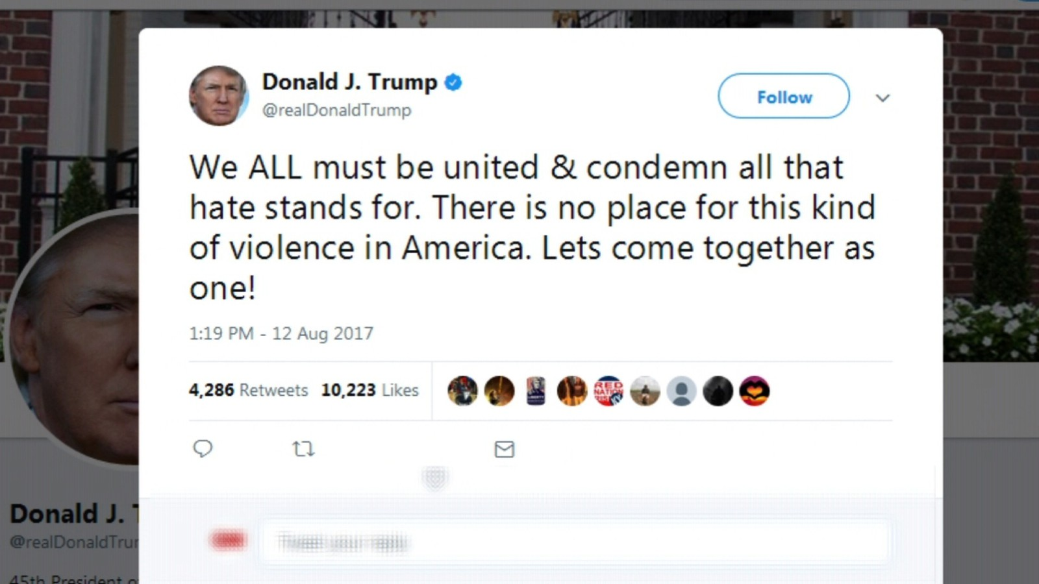

Twitter - Charlottesville rally (2017)
Tweets: short text – dense in information $→$ works with ’’small” data

Slide 6
Data collection and cleaning
Get tweets through twitter API
Sort by #Charlottesville and tweets mentioning ’’Charlottesville”
Get rid of retweets
Filter for location and time interval

Slide 7
The plan of action
Report 1:
Acquire data through Twitter API
Clean the data, prepare preprocessing pipeline
Find a way to configure graph-tools
Report 2:
Get a grasp on topic modeling algorithms (LSA, pLSA, LDA)
Apply the algorithms to get results
Report 3:
Try out hSBM community detection method
Compare results with baseline
Draw final conclusions

